Slide 1
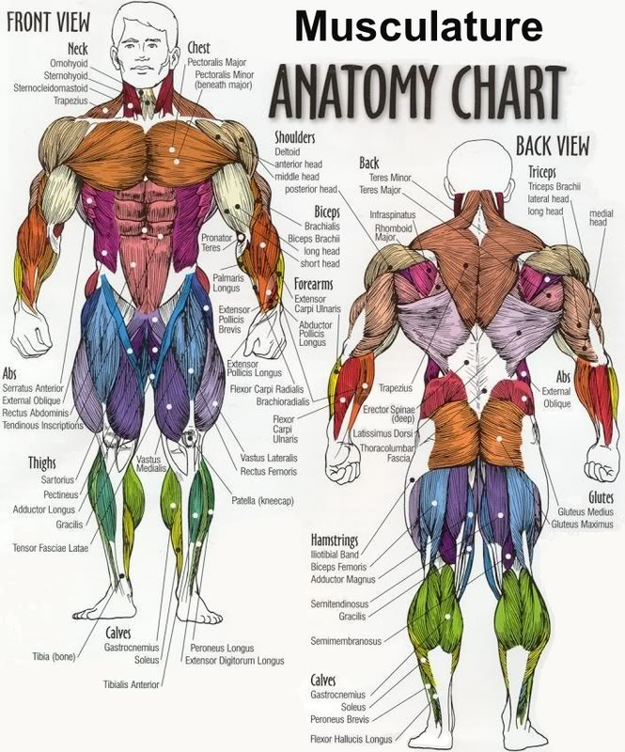
PSE 4UI
Muscle
Anatomy
Pre-Test
/42

Slide 2
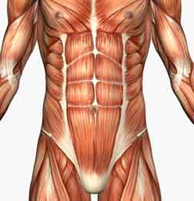
1-
2-
3-

Slide 3
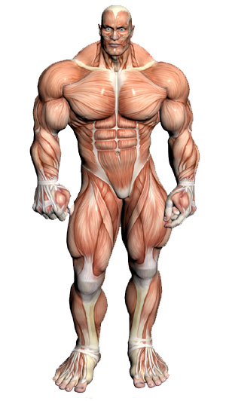
4-
5-
6-

Slide 4
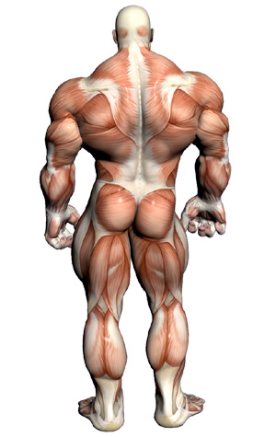
7-
8-
9-

Slide 5
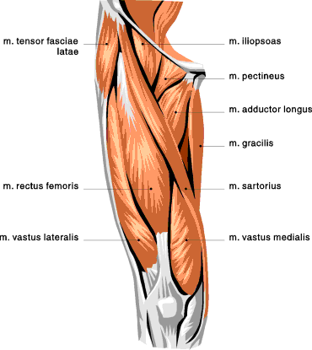
10-
11
-
10-
12

Slide 6
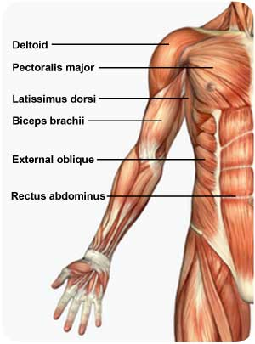
13
14

Slide 7
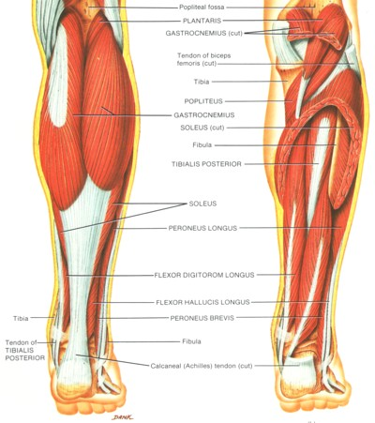
15
16

Slide 8
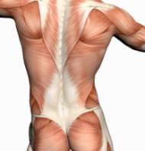
17
18

Slide 9
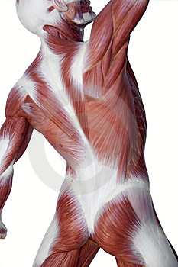
19
20

Slide 10
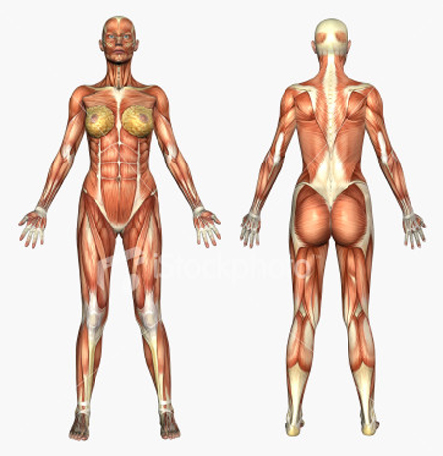
21
22

Slide 11
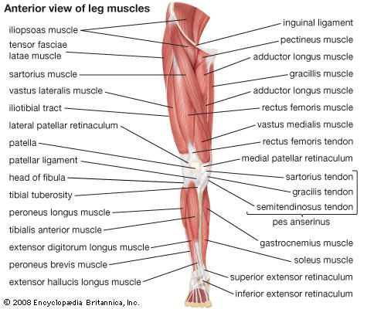
24
23
25
26

Slide 12
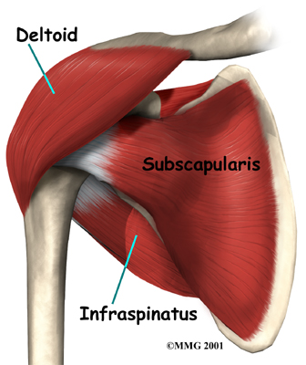
27
28

Slide 13
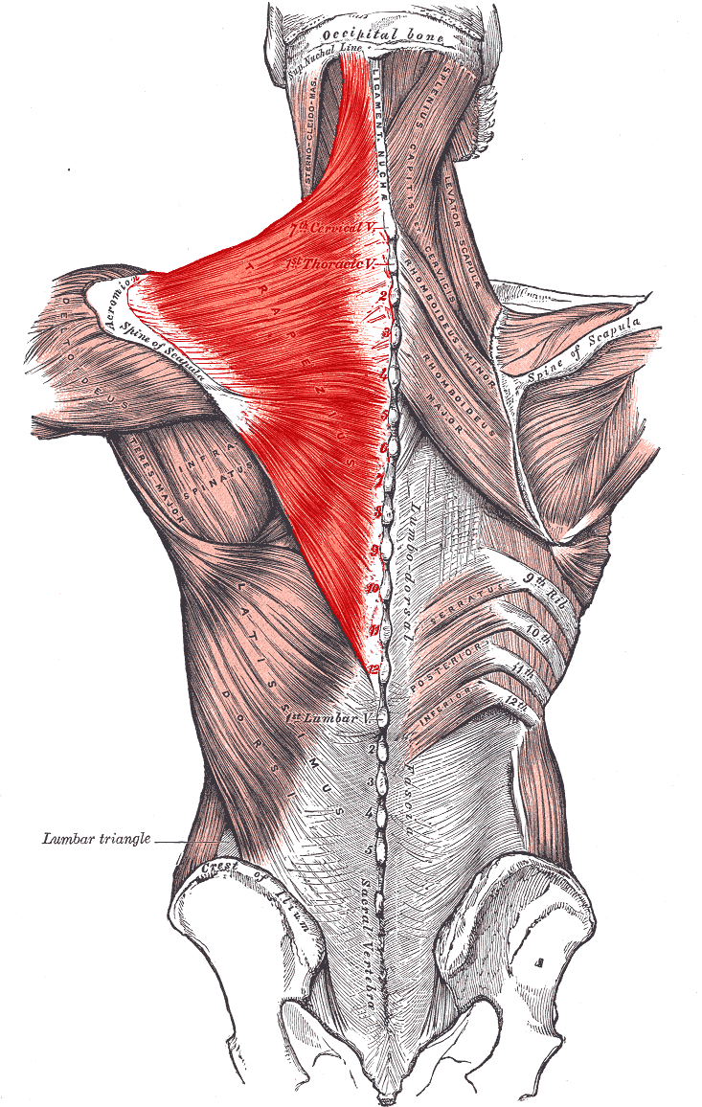
29
30

Slide 14
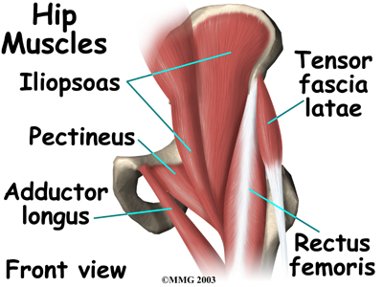
31
32

Slide 15
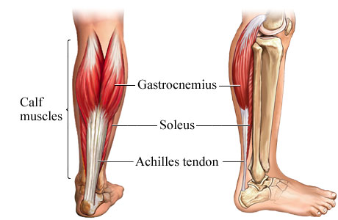
33
34

Slide 16
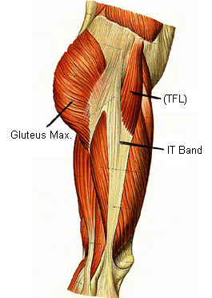
35
36

Slide 17
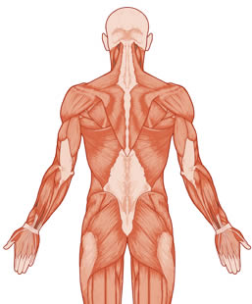
39
37
38

Slide 18
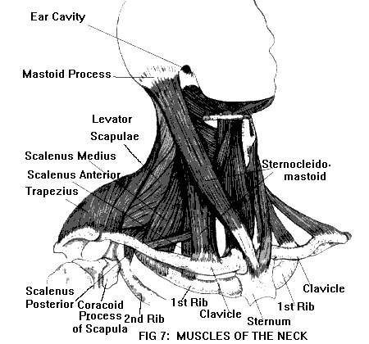
40

Slide 19
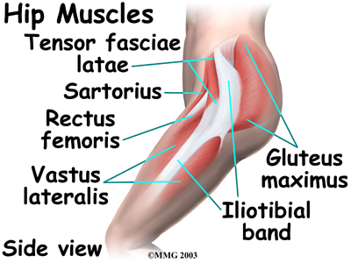
41
42

Slide 20
PSE 4UI
Muscle
Anatomy
Pre-test
Answers

Slide 21
1- pectoralis major
2-rectus abdominus
3-external obliques

Slide 22
4-deltoids
5-biceps brachii
6-rectus femoris

Slide 23
7-trapezius
8-latissimus dorsi
9-Action: Knee flexion

Slide 24
10-
11
-
12

Slide 25
13
14

Slide 26
15
16

Slide 27
17- Supraspinatus
18- Gluteus medius

Slide 28
19-Action: Neck rotation
20- Terres minor

Slide 29
21-
wrist flexors
22-
wrist extensors

Slide 30
23
24
25
26

Slide 31
27
28

Slide 32
29-trapezius
30-rhomboids or shoulder stabilizers

Slide 33
31
32

Slide 34
33
34

Slide 35
35
36

Slide 36
39-brachioradialis or
wrist extensors
37
38

Slide 37
40

Slide 38
41
42

