Slide 1
Ecosytem Interactions

Slide 2
Biotic Interactions
Competition
Predation
Symbiosis

Slide 3
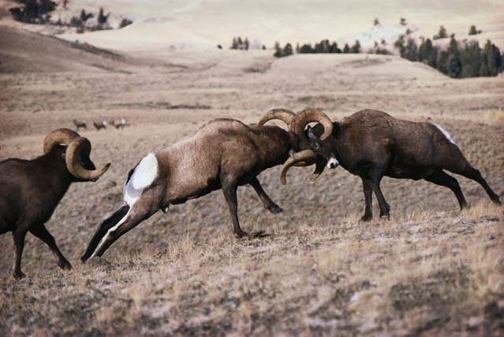
Competition
The interaction between two or more organisms for the same resource in a given habitat.
Ex. Male mountain goats who compete to mate.

Slide 4
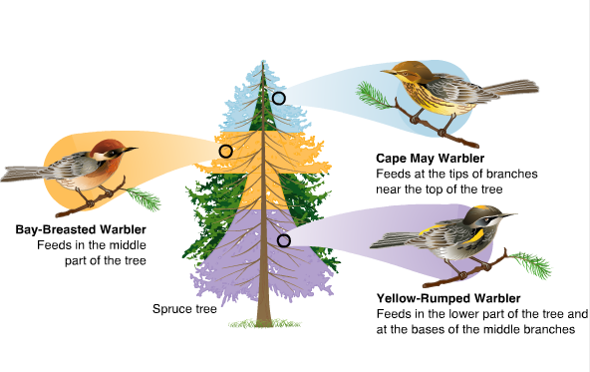
Competition
For similar species to coexist in an area, they must have slightly different niches

Slide 5
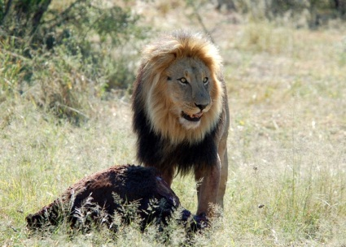
Predation
Occurs when one organism eats another organism to obtain food.
Many animals use camouflage to avoid predators.

Slide 6
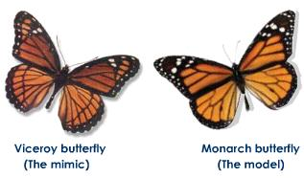
Predation
Some species use mimicry to avoid predators.
Ex. The viceroy butterfly looks like the monarch. Both taste foul and they have a greater change of not being eaten because their predators avoid them.

Slide 7
Symbioisis
Close interaction between two different species
Three types
Mutualism
Commensalism
Parasitism

Slide 8
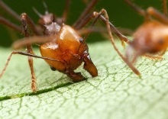
Mutualism
Both species benefit fro the partnership
Ex. Leaf cutter ant and the fungus

Slide 9
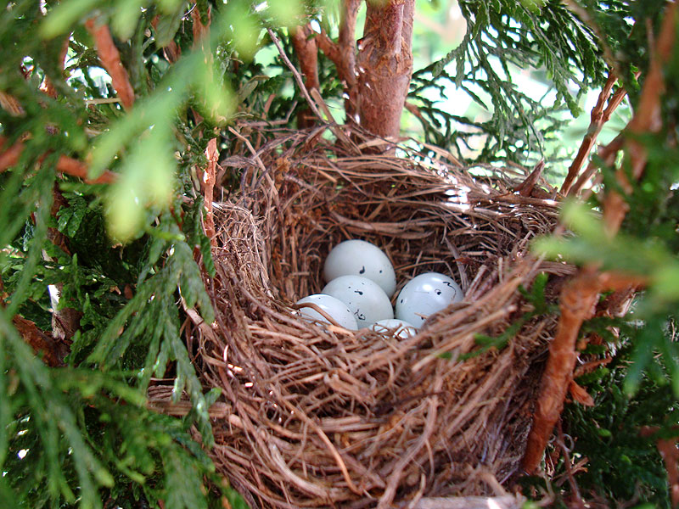
Commensalism
One species benefits fron a relationship with another species without harm or benefit to the other .
Ex. Bird building a nest in a tree

Slide 10
Parasitism
When species benefits at the expense of another species.

Slide 11
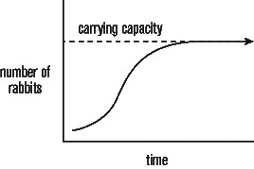
Charcteristics of Populations
Eventually the number of births and deaths in a population balance out.
The carrying capacity is the maximum number of individuals of a population that an ecosystem has resources to support.

Slide 12
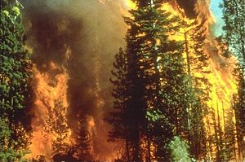
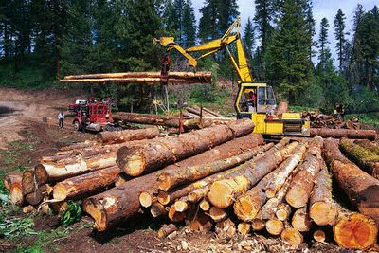
Factors that affect Populations in Ecosystems
A limiting factor is an environmental factor that prevents an increase in the number of organisms in a population.
Abiotic: water, sunlight, fires, logging, droughts
Biotic: predators, competition for resources, disease

Slide 13
Videos
http://www.youtube.com/watch?v=D1aRSeT-mQE
http://www.youtube.com/watch?v=zSmL2F1t81Q&feature=fvwrelhttp://www.youtube.com/watch?v=KrWk2g-IMkE&feature=related

