Slide 1
Human impacts on ecosystems
Biodiversity Loss

Slide 2
Human impacts on Biodiversity
Ecosystems provide humans with many services.
Ecosystems supply food, fuel, water, they regulate climate and provide humans with cultural and recreational opportunities.
Sustainable use of an ecosystem means using resources in a way that meets our current needs without compromising our future.

Slide 3
Human impacts and biodiversity
Human activity has caused biodiversity to decrease at an unprecedented rate.
The causes of these losses are varied and can be summarized in the term HIPPO(C):
Habitat Loss
Invasive species
Overexploitation
Pollution
Population Growth
Climate change

Slide 4
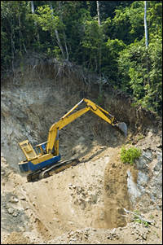
Habitat Loss
Habitat loss directly affect the species that rely on the habitat that is being changed.
Habitat loss is particularly serious in southern Ontario where urbanization, agriculture and road density are greatest.
Habitat fragmentation occurs when a large region is broken up into small patches, for example forests interspersed among farms, suburbs and cities.

Slide 5
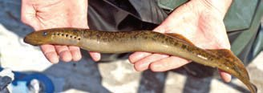
Invasive species
Invasive species are harmful non-native species whose introduction or spread threatens the environment, the economy and society, including human health.
Come from other continents, adjacent countries or from other ecosystems within Canada.
Free from predation and competition many invasive species reproduce rapidly and damage, displace or destroy native species

Slide 6
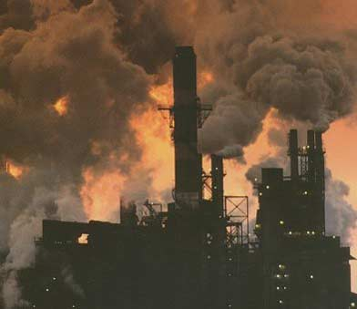
Pollution
Pollution is emitted in many different forms, including atmospheric pollution, soil and water pollution, pesticides, particulate matter, and heavy metals.
These materials have significant, large-scale impacts on forests and aquatic ecosystems

Slide 7
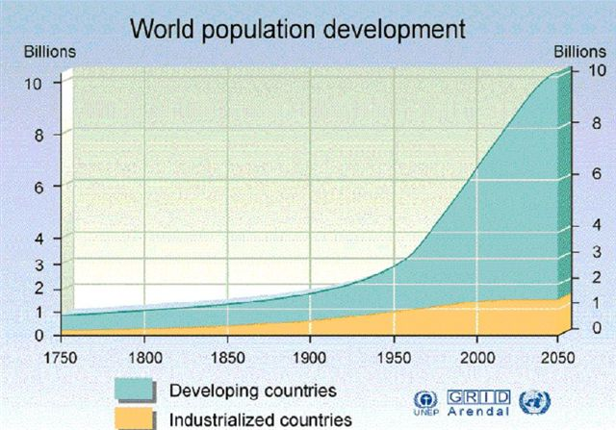
Population growth
Population growth. Human population growth adds to the impact of all the other causes because more people require more space and more resources.

Slide 8
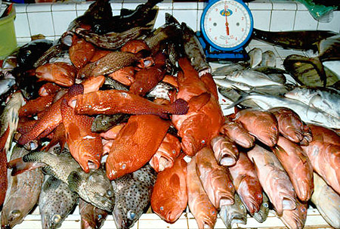
Overexploitation
Overexploitation is the harvest of species at a rate higher than can be sustained by the natural reproduction of the population.
In Ontario, wild American ginseng has been to the point of being Endangered.

Slide 9
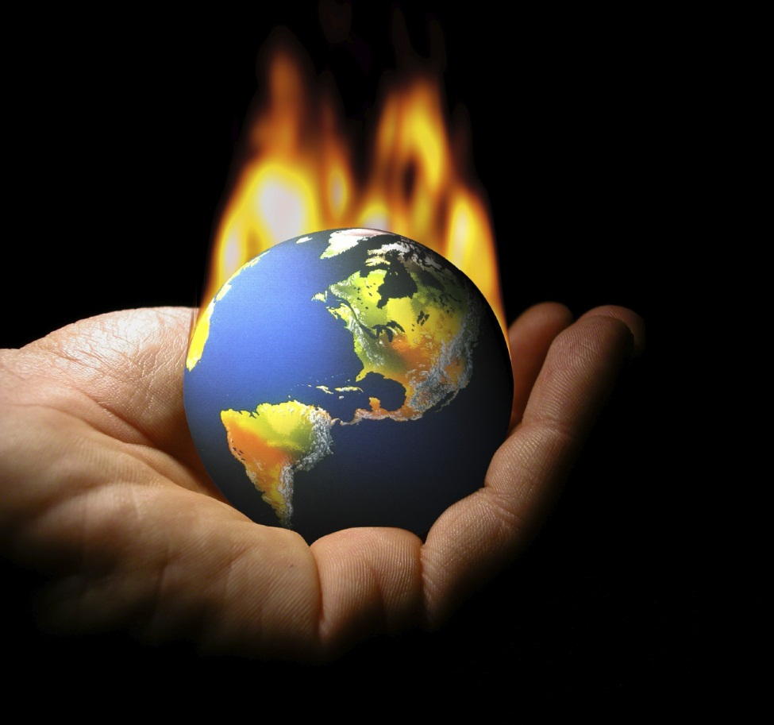
Climate change
People have added carbon dioxide and other greenhouse gases to the atmosphere by burning fossil fuels such as coal and natural gas.
These gases trap heat and accelerate the rate of global warming
Climate change is a major threat to the world's biodiversity.

Slide 10
Why should you care about biodiversity?
You are a part of biodiversity.
Everything is connected.
Natural systems based on healthy biodiversity provide all kinds of services for you…for free!
You have to live with what's left.
Notes:
You are a part of biodiversity. The same things that affect bugs, trees and fish have an impact on you too — the quantity of clean, fresh water, or the quality of the air we breathe.
Everything is connected. The health of biodiversity affects you. And what you do affects biodiversity. Everything we do either uses natural resources or returns them as waste. The amount of land and resources that a population or a person uses is called an ecological footprint. We all can do things to make our personal footprints smaller.
·Natural systems based on healthy biodiversity provide all kinds of services for you…for free! Things like cooling and filtering air, controlling floods, pollinating plants, controlling pests, aerating soil, and filtering and storing water. These ecosystem services would cost a lot if we had to (or even could) use technology to provide them. These services are called ecosystem services.
·You have to live with what's left. A wise saying states “We don't inherit the earth from our parents, we borrow it from our children.”

